Slide 1
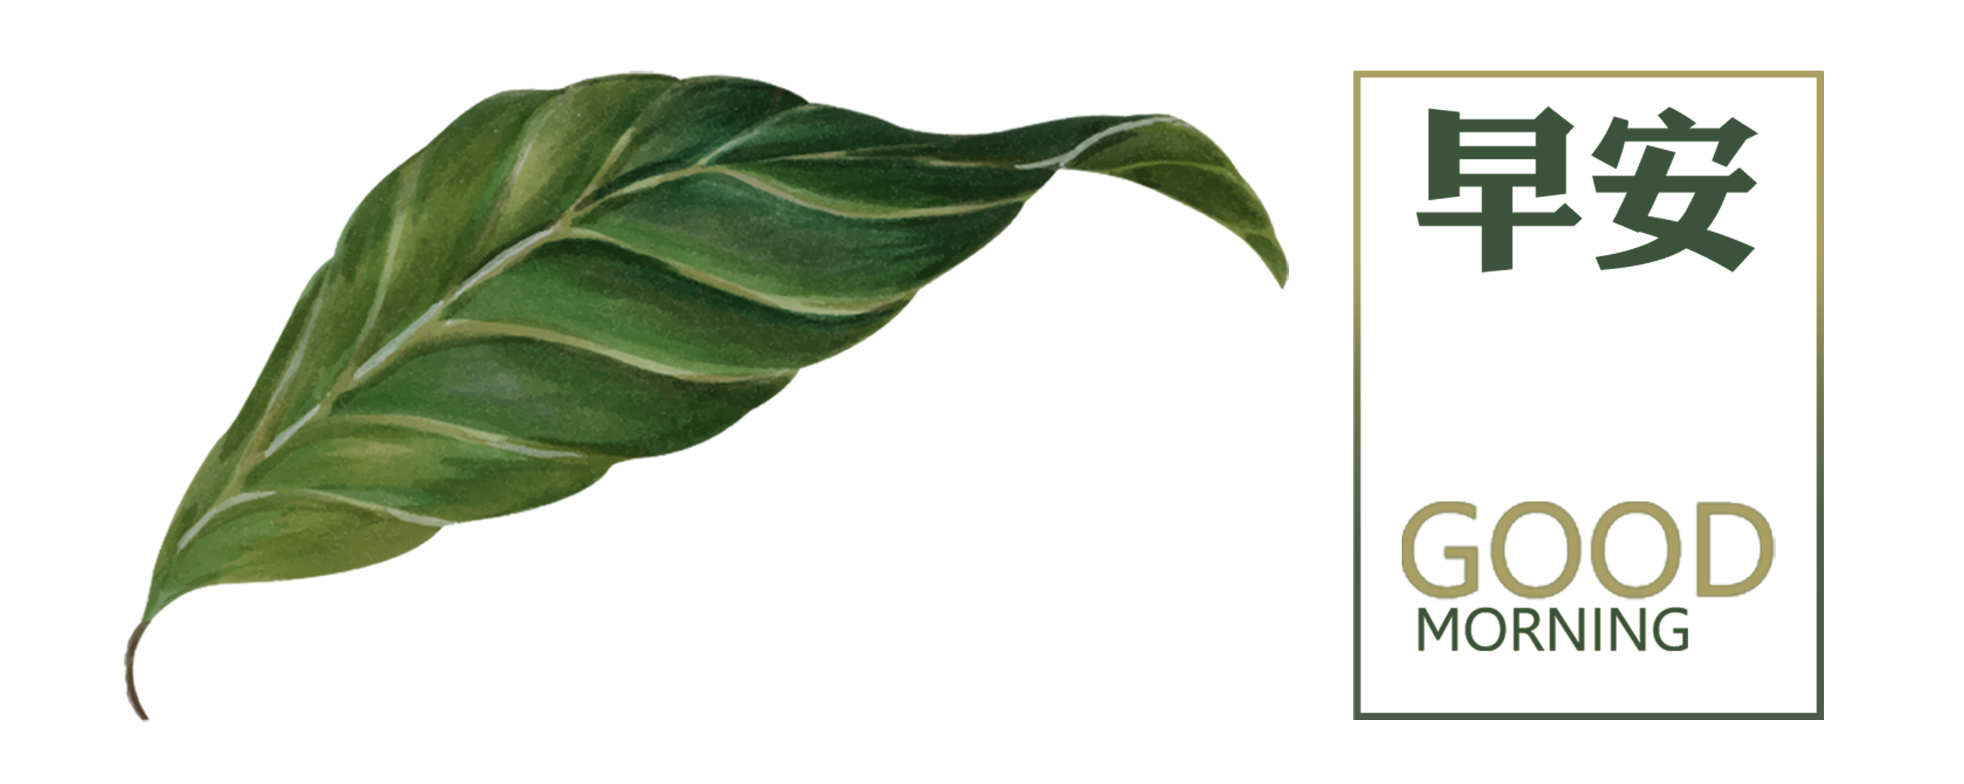
Plant Disease Classification
By:
Neural Ninjas

Slide 2
CONTENTS
1
Introduction
2
Roadmap
3
Approach Proposal
4
Conclusion

Slide 3
01
Introduction and Problem Statement

Slide 4
Problem Statement
Plant diseases can cause significant damage to crops, leading to financial losses for farmers.
Solution: Develop a machine learning or Deep Learning model that can accurately classify plant diseases from images, allowing farmers to take preventive measures early on.
OBJECTIVES:
To identify the plant disease.
To classify the plant disease.
To predict the severity of the plant disease.
To track the spread of the plant disease.
To develop new treatments for plant diseases.

Slide 5
CONSTRAINTS:
Accuracy
Computational Resources
Generalization
Interpretability

Slide 6
02
Roadmap

Slide 7
Roadmap
Data collection
Data preprocessing
Model training
Model evaluation
Model deployment

Slide 8
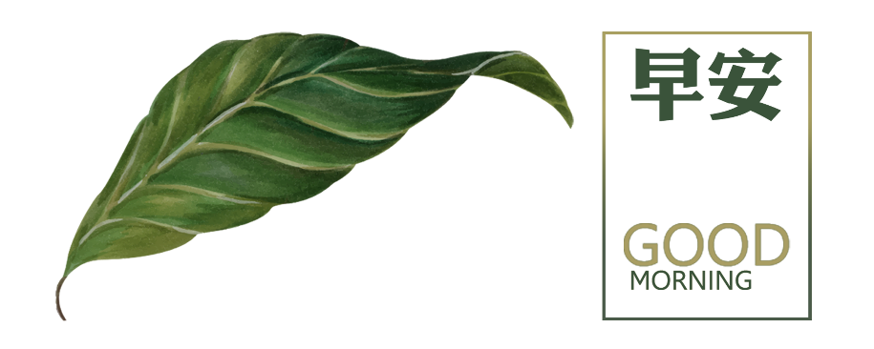
Alternative Approaches for the Project
Utilizing Pre-trained Models
Training a Model from Scratch
Transfer Learning
Ensemble Methods

Slide 9
03
Approach Proposal

Slide 10
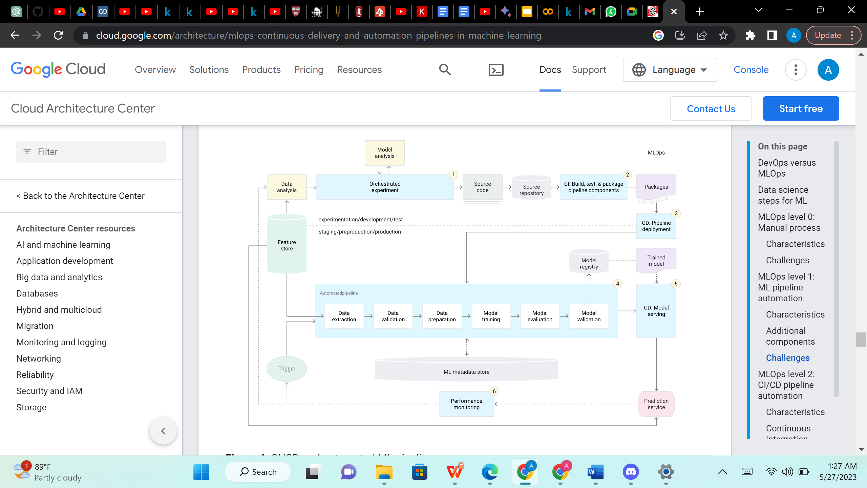
Architecture

Slide 11
Proposed Approach
In the pursuit of plant disease classification, we have explored different models, including convolutional neural networks (CNNs), with a particular focus on ResNet and VGG16.
CNNs are specialized deep learning algorithms for image classification, enabling them to recognize patterns and categorize images accordingly.
ResNet, a powerful CNN architecture, excels in capturing long-range dependencies within images, making it ideal for complex or diverse plant disease classification tasks.
VGG16, another effective CNN model, specializes in learning local features in images, making it well-suited for classifying detailed or simpler plant disease images.
By considering and experimenting with these CNN models, I aim to devise an optimal approach for accurate plant disease classification.

Slide 12
04
Conclusion

Slide 13
CONCLUSION
In conclusion, the exploration of different models for plant disease classification has provided valuable insights. Convolutional neural networks (CNNs) such as ResNet and VGG16 have been shown to be effective at classifying plant diseases. ResNets excel in capturing long-range dependencies, while VGG16s focus on local features. By leveraging the strengths of these models, we can develop an effective approach that improves the accuracy of plant disease classification.
The findings from this investigation will contribute to the development of a robust and reliable system for automated plant disease diagnosis. This will enable more effective management of crop health.
I hope this helps! Let us know if you have any other questions.

Slide 14
Thank you

